Slide 1
05 | Security
Jeremy Likness | Principal Architect
Christopher Harrison | Content Developer

Slide 2
Module Overview
Authentication in the Host
Authentication using Message Handlers
Token-based Authentication
Authorization Filters
Custom Authorization Filters
Role-based Authorization
Preventing Cross-Site Request Forgery

Slide 3
Authentication in the Host
Configuring your Web API Project

Slide 4
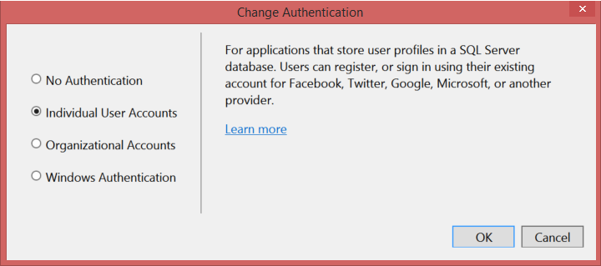
Authentication in the Host
Default assumption by Web API
Usually MVC or other app as “wrapper”

Slide 5
Authentication in the Host
Notes:
04aModelValidation

Slide 6
Authentication using Message Handlers
Fine-grained control

Slide 7
Authentication using Message Handlers
Derive from DelegatingHandler
Override SendAsync
Look for credentials as needed
If the user is authorized, create an identity
Create a principal based on the identity
Set the current user for the context (you may also set the thread principal, but this will affect how other operations are performed)

Slide 8
Authentication Using Message Handlers
Notes:
04aModelValidation

Slide 9
Token-based Authentication
You do hang onto your tokens, don’t you?

Slide 10
Token-based Authentication
Authorization generates a token
Tokens given access to resources
Protects revealing password to app if token is generated by a third-party (i.e. Facebook, Google, Microsoft Account, Twitter, etc.)
A controller with support is generated in the Web API template when you select “individual accounts”
Token is passed in the header
Can also create your own provider/parser

Slide 11
Token-based Authentication
Notes:
04aModelValidation

Slide 12
Authorization Filters
Attribute it to security

Slide 13
Custom Authorization Filters
Security done your way

Slide 14
Role-based Authorization
A role-playing API

Slide 15
Preventing Cross-Site Request Forgery
Your public service anti-XSRF message

